Slide 1

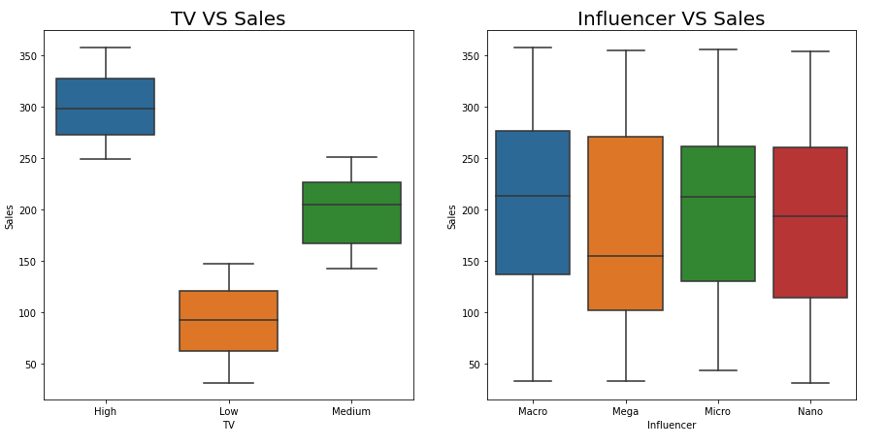
Maximizing Sales: The Impact of TV Promotion Budget Levels
Prepared for: Marketing Team
The analysis conducted by the marketing data team focused on understanding the impact of TV promotion budgets on sales, sidelining the Influencer feature due to its insignificant effect as shown in the plot below. The examination revolved around categorizing TV budgets as low, medium, and high to discern their distinct influences on sales figures using ANOVA and Post Hoc test.
The primary aim was to quantify the contribution of varied TV promotion budget levels to sales, leveraging OLS model to isolate and estimate the effect of each category, with an emphasis on the high budget category as a benchmark.
TV promotion significantly drives sales, explaining 87.1% of the sales variance (R-squared: 0.871).
Increasing the TV budget from low to high predicts a $209.8691 million rise in sales.
Elevating the TV budget from medium to high is linked to a $105.4952 million sales increase.
The importance of TV budget levels is statistically validated by significant p-values (<0.05).
Prioritize and increase investment in TV promotions to capitalize on its proven efficacy in driving sales.
Conduct further analysis to optimize the TV promotional budget, ensuring the highest possible return on investment.
Notes:
Image Credits
Android Phone Icon: Created by Devendra Karkar from the Noun Project
iPhone Icon: Created by Landan Lloyd from the Noun Project

